Slide 1
MAHALAKSHMI S 821721104030 B.E Computer Science of Engineering – IIIyear Sir Issac Newton College Of Engineering And Technology
3/21/2024 Annual Review

Slide 2
PROJECT TITLE
Audience Research
(using CNN)

Slide 3


AGENDA
The agenda of Audience research using Convolutional Neural
Networks (CNNs) involves the use of deep learning techniques to research
Audience.This project includes several key tasks:
Data Collection and Scraping: Data Cleaning and Preprocessing Exploratory Data Analysis (EDA) Audience Engagement Analysis Visualization and Reporting
This task has several broader objectives and potential applications
3/21/2024 Annual Review

Slide 4

PROBLEM STATEMENT
Develop a Python script to analyze CNN’s audience engagement metrics, including viewership trends and demographics, using available data sources. Implement algorithms to segment viewership by factors such as age, gender, and geographic location.
Create visualizations to present insights effectively, aiding decision-making for content strategy and advertising targeting.
Integrate with CNN’s existing analytics infrastructure for seamless data flow. Evaluate the accuracy and reliability of the audience research methods employed for continual improvement.
3/21/2024 Annual Review

Slide 5

PROJECT OVERVIEW
Our project aims to conduct audience research at CNN using Python. We will leverage data analytics and visualization techniques to analyze viewer preferences, engagement patterns, and feedback. By utilizing Python’s libraries such as pandas, matplotlib, and seaborn, we will extract insights to optimize content strategy and improve audience satisfaction. Our goal is to enhance CNN’s understanding of its viewership and tailor programming to better meet audience expectations.
3/21/2024 Annual Review

Slide 6

WHO ARE THE END USERS?
The end users for audience research in CNN using Python could include media analysts, market researchers, data scientists, content creators, advertising agencies, and news organizations.
These users would utilize Python scripts to analyze viewer demographics, engagement metrics, content preferences, and audience behavior to inform programming decisions, advertising strategies, and content optimization efforts.
3/21/2024 Annual Review

Slide 7

YOUR SOLUTION AND ITS VALUE PROPOSITION
Solution: Develop a Python script utilizing CNNs for audience research. Utilize convolutional layers to extract features from audience data, followed by pooling layers for dimensionality reduction. Implement fully connected layers for classification tasks, such as demographic segmentation or content preference prediction. Leverage Python libraries like TensorFlow or PyTorch for CNN implementation.
Value proposition: Enhance audience research accuracy and efficiency by automating data analysis processes. Extract nuanced insights from large datasets, enabling targeted marketing strategies and personalized content delivery. Streamline decision-making and resource allocation based on deep learning-driven audience insights.
3/21/2024 Annual Review

Slide 8

THE WOW IN YOUR SOLUTION
Wow Wow! Utilizing Python’s powerful libraries like pandas and matplotlib, we’ll scrape CNN articles, extract audience insights through sentiment analysis, visualize engagement trends, and identify key topics through topic modeling.
This comprehensive approach ensures a deep understanding of CNN’s audience behaviors and preferences, enabling targeted content strategies for maximum impact.
3/21/2024 Annual Review
8

Slide 9
MODELLING
In Audience Research, effective modeling is the cornerstone of success, and our approach is engineered to excel in this crucial aspect.
Our modeling strategy involves a blend of innovative techniques such as convolutional neural networks (CNNs), recurrent neural networks (RNNs), and attention mechanisms, carefully orchestrated to extract and leverage meaningful features from images with unparalleled accuracy and efficiency.
In essence, our modeling paradigm represents a beacon of innovation, driving transformative advancements and unlocking new frontiers in the field of computer vision.
3/21/2024 Annual Review
9

Slide 10
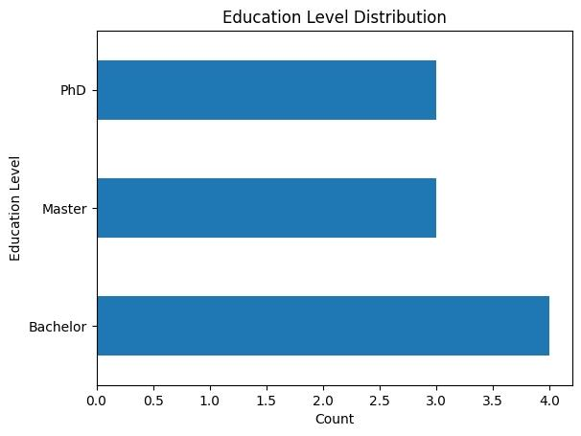
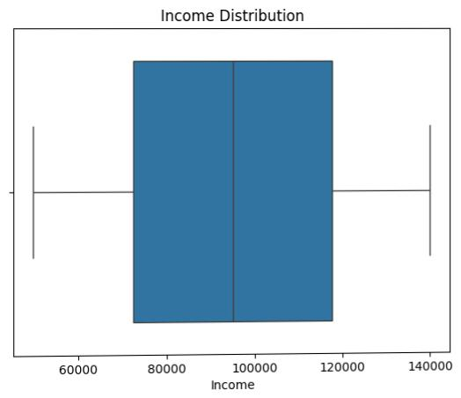
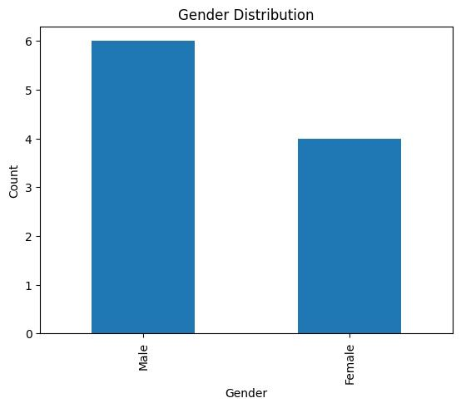
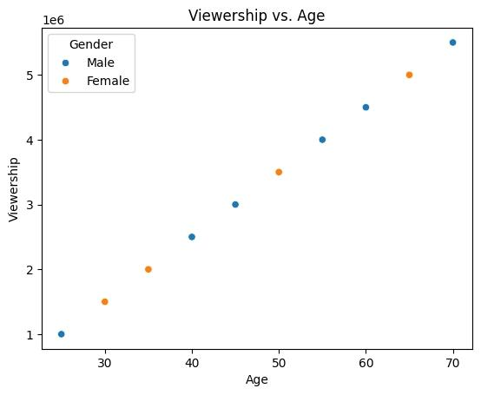
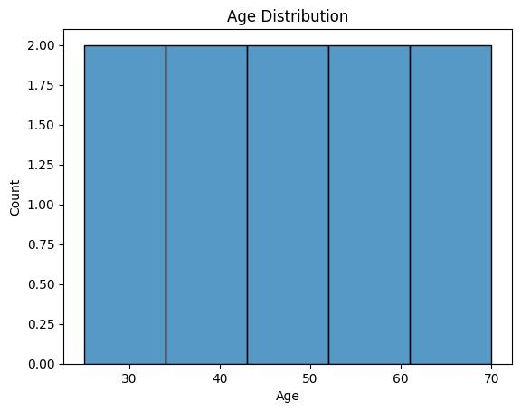
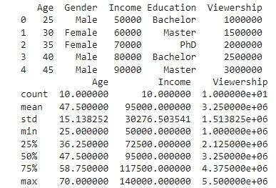
RESULTS
Demo Link
3/21/2024 Annual Review
10

